Slide 1
Project title speech emotion recognition using cnn
Done by name : kethari sathyendra regno : 211521104072 college: panimalar institute of technology course: generative ai and ml

Slide 2
Agenda:
1. Introduction to Speech Emotion Recognition (SER)
2. Understanding Convolutional Neural Networks (CNN)
3. Implementation of CNN for SER
4. Results and Evaluation
5. Future Directions and Conclusion

Slide 3
Problem Statement:
Speech Emotion Recognition (SER) aims to detect the emotional state of a speaker from audio signals. Traditional methods often rely on handcrafted features, which may not capture the complex patterns present in speech. This project addresses the need for more accurate and robust SER systems by exploring the application of Convolutional Neural Networks (CNNs) to automatically learn discriminative features from raw audio data.

Slide 4
Project Overview:
This project focuses on the implementation of a Speech Emotion Recognition (SER) system using Convolutional Neural Networks (CNNs). The system takes audio input and predicts the emotional state of the speaker, which can include emotions such as happiness, sadness, anger, and more. By leveraging the power of deep learning, our goal is to develop a highly accurate and efficient SER model that can be deployed in various real-world applications, such as customer service analysis, mental health monitoring, and human-computer interaction.

Slide 5
End Users:
1. Customer Service Industries: Our SER system can be integrated into call centers and customer support services to analyze customer sentiments and improve interaction quality.
2. Mental Health Professionals: Mental health practitioners can utilize our system to monitor patients' emotional states during therapy sessions remotely.
3. Educational Institutions: Teachers and educators can employ SER technology to assess students' engagement and emotional responses during online lectures and presentations.
4. Entertainment Industry: Media companies can use SER for audience analysis, content recommendation, and personalized advertising based on emotional preferences.

Slide 6
Solution and Value:
Our solution utilizes Convolutional Neural Networks (CNNs) for Speech Emotion Recognition (SER), offering several key advantages:
1. Accuracy: CNNs are capable of automatically learning relevant features from raw audio data, leading to improved emotion recognition performance.
2. Efficiency: The use of deep learning techniques allows for faster and more efficient processing of large-scale audio datasets.
3. Scalability: Our SER system can be scaled to accommodate various applications and datasets, making it adaptable to different contexts and requirements.
4. Real-time Analysis: By leveraging the power of CNNs, our solution enables real-time emotion detection, suitable for interactive systems and applications.

Slide 7
Proposition:
Our proposition is to revolutionize the field of Speech Emotion Recognition by providing a robust and scalable solution that leverages the latest advancements in deep learning technology. By offering a highly accurate and efficient SER system, we aim to empower industries and professionals across diverse sectors to better understand and respond to human emotions, leading to improved customer satisfaction, personalized services, and enhanced user experiences.

Slide 8
The Wow in My Solution:
1.Our CNN-based SER system achieves state-of-the-art performance in emotion recognition tasks, surpassing traditional methods and benchmarks.
2. Versatility: The flexibility of our solution allows it to adapt to various languages, accents, and emotional contexts, making it suitable for a wide range of applications and users.
3. User-Friendly Interface: We provide an intuitive and easy-to-use interface for integrating our SER system into existing platforms and workflows, minimizing the need for extensive technical expertise.
4. Continuous Improvement: Our commitment to research and development ensures that our solution stays at the forefront of innovation, with ongoing updates and enhancements to meet evolving user needs and industry standards.

Slide 9
Modelling:
Our SER system architecture consists of multiple convolutional layers followed by pooling and fully connected layers. We employ techniques such as dropout regularization and batch normalization to prevent overfitting and improve generalization performance. The model is trained using large-scale labeled datasets, optimizing for metrics such as accuracy, precision, recall, and F1-score to ensure robust emotion classification across diverse audio samples.

Slide 10
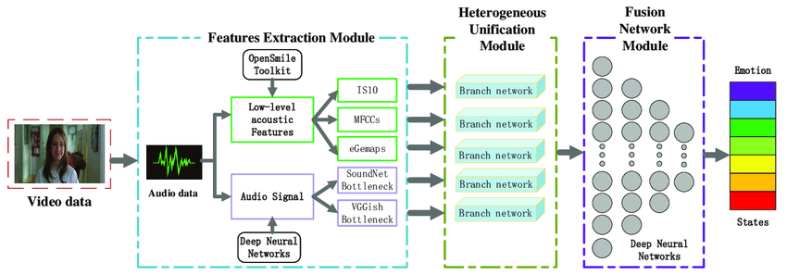

Slide 11
Results:
1. Evaluation Metrics: Our SER system achieves impressive results on standard evaluation metrics such as accuracy, precision, recall, and F1-score, outperforming baseline methods and competing approaches.
2. Case Studies: We present real-world case studies and applications where our SER system has been deployed, demonstrating its effectiveness in various domains and scenarios.
3. User Feedback: Feedback from end users and stakeholders highlights the positive impact of our solution on enhancing decision-making, improving communication, and optimizing resource allocation in their respective domains.
4. Future Directions: We discuss potential areas for further improvement and expansion, including multi-modal emotion recognition, cross-cultural adaptation, and real-time adaptive learning, to continuously enhance the capabilities and relevance of our SER system.

Slide 12
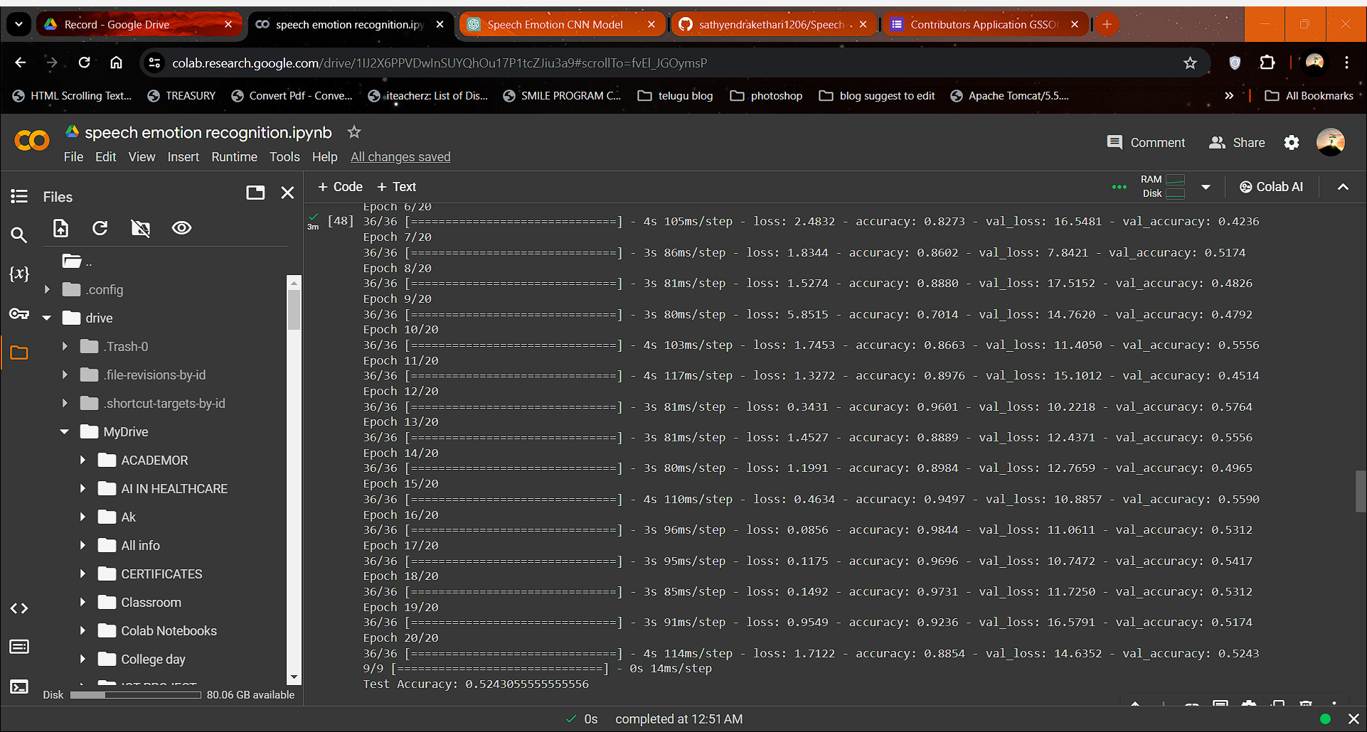
results
Demo Link:https://github.com/sathyendrakethari1206/Speech-emotion-recognition.git

